Slide 1
GANESH COLLEGE OF ENGINEERING
SMART PUBLIC RESTROOM
Y.ESTHER(leader)
K.ANUSHA
T.GOPIKA G.SUBASRI

Slide 2
INTRODUCTION
▶ 1.Abstract
▶ 2.Analysis of the smart toilet system
▶ 3.Data security
▶ 4.Acknowledements
▶ 5.Conclusions

Slide 3
INTRODUCTION
▶ Intelligent toilet, public restroom and smart toilet restroom designed in ITALY by our partner TOILITECH.
▶ Our upmost design offers almost any budget from the basic manual specification to our powerful PLUS and SMART technology fully automated, smart restroom technology.

Slide 4
ABSTRACT
▶ As the world population is increasing the safety and health issues is one of most alarming sectors.
▶ Smart public sanitation system for health safety.
▶ We are automatically day and night light control system
▶ In an addition we also used and water level indicator to measure the water level
▶ For emergency situation user an emergency exit button have used all output operations system

Slide 5
▶ Smart sanitation system to improve human behaviour using flush system and reduce toilet related diseases.
▶ This project has been designed with experimental methodology to fulfill the vision of substance world from third world countries.
▶ Smart revolutionary invent to ensure the health safety in public sanitation.

Slide 6
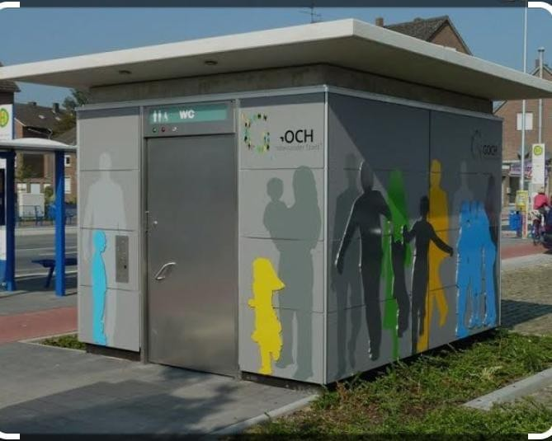
Rest room

Slide 7
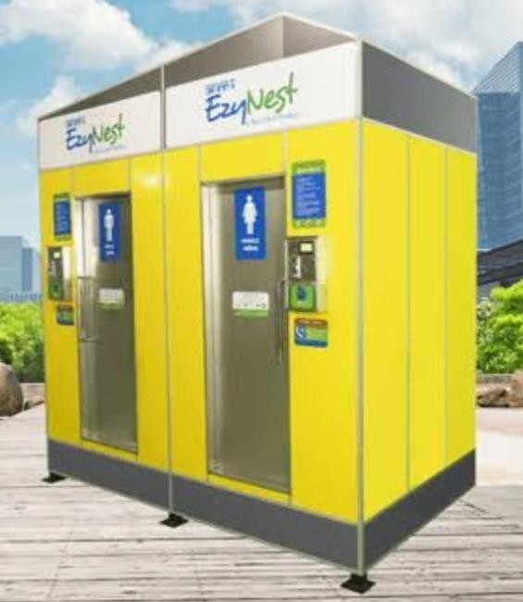
MODEL

Slide 8
Smart public toilet solution of Dusun smart IoT gateway
▶ Smart sensors: Install smart sensors in public toilets, such as temperature sensors, humidity sensors, gas sensors.
▶ Monitor the environmental conditions of public toilets in real time, including temperature, humidity gas, concentration etc.
▶ Intelligent Controller: The basis of the intelligent gateway intelligent Controller.
▶ Ventilation and other facilities of the public toilet to improve the comfort and energy saving effect of the public toilet.

Slide 9
Smart public toilet can be realized by referring to the gateway
▶ Automatic induction : smart public toilet products solutions can realize automatic induction flushing hand washing, lighting and other functions without manual operation , saving time and energy
▶ Environmental monitoring: smart public toilet products solutions can monitor the temperature, humidity, odor and other environmental parameters in the public toilet.
▶ Smart cleaning: smart public toilet product solutions can realize smart cleaning.
▶ Seurity monitoring: smart public toilet product solutions can understand user habits and needs through data collection and analysis.

Slide 10
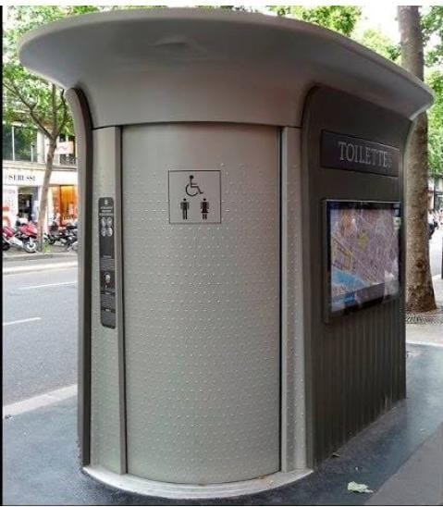
AUTOMATIC induction clean

Slide 11
MARKETING DESIGN
▶ One device even features an “anus camera” that take a photo from below for
identifications.
▶ something that has been described as the “polar opposites of facial recognition”.
▶ A disease – detecting precision health toilet can sense multiple sign of illness through automatically urine and stool analysis.
▶ Government officials in China were so exasperated by the volume of theft a particular item from one public bathroom
▶ They resorted bro extreme measures.
▶ In 2017 facial recognition software in the rest room at the temple.

Slide 12
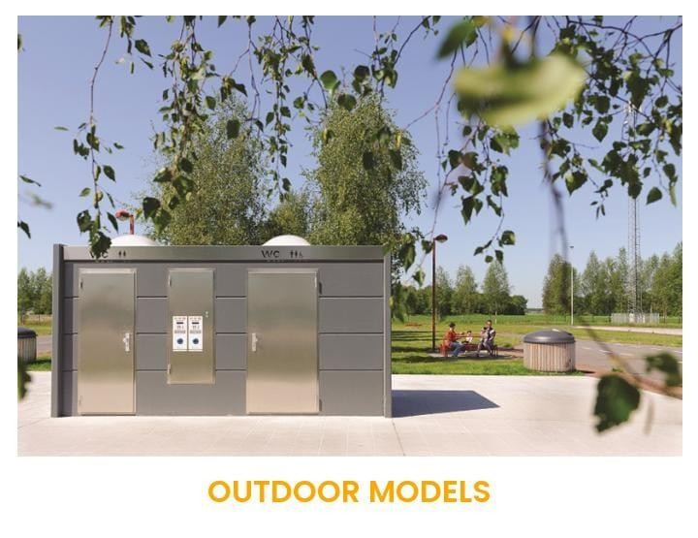
OUTDOOR MODELS

Slide 13
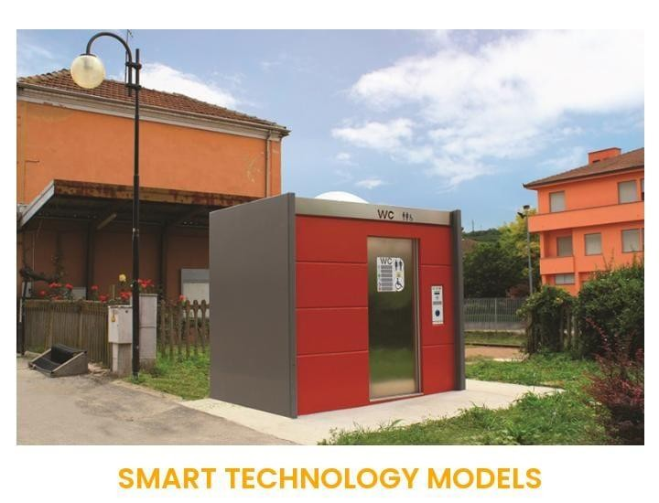
Smart Technology Model

Slide 14
SMART PUBLIC RESTROOM FEATURES
▶ A operate
pre& post flush.
▶ Periodic automatic power spary cleaning.
▶ Light inside operated automatically.
▶ IoT enabled panel usage status communication.

Slide 15
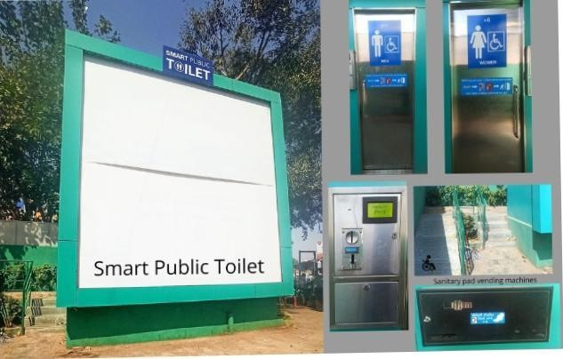
FEATURES

Slide 16
The Future of Smart Restroom Technology
▶ Future of smart restroom technology looks promising, with continuous advancements and innovations on the horizon. Here are some key trends that are shaping the future of smart restrooms:
▶
▶ AI-powered Systems: Artificial Intelligence (AI) is expected to play a significant role in the evolution of smart restrooms. AI algorithms can analyze complex data patterns, predict usage trends, and optimize resource allocation. AI-powered systems can also enhance user experience by personalizing settings based on individual preferences.

Slide 17
Integration with Smart Buildings
▶ Smart restrooms are increasingly being integrated into larger smart building ecosystems
▶ This integration allows for seamless communication and coordination between different building management systems, such as lighting, HVAC, and access control.
▶ By leveraging the power of interconnected systems, smart buildings can optimize resource utilization and provide a holistic user experience.

Slide 18
SMART PUBLIC RESTROOM IN MQTT PROTOCOL
▶ The study focuses on saving clear water from the use of an automatic usinal flushing system in a toilet.
▶ The system uses MQTT as an under lying communication protocol
▶ The protocol is used in collecting ,controlling , commanding and debugging the system .

Slide 19
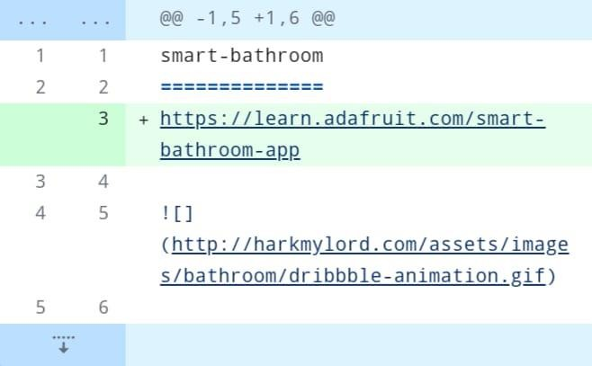
SMART PUBLIC RESTROOM IN BEECEPTOR COLUD

Slide 20
ADVANTAGES
▶ Smart restroom solutions offer the desired adaptability and flexibility.
▶ The modular construction of restroom cubicles allows for easy reconfiguration, ensuring efficient space utilization.
▶ This versatility makes restroom designs future-proof, enabling optimization of facilities according to changing demands.

Slide 21
CONCLUSION
▶ Smart restroom technology is transforming the way we experience public and private restrooms
▶ With features like occupancy sensors, odor detection, and supply level monitoring, smart restrooms enhance hygiene, efficiency, and user satisfaction.
▶ The implementation of smart restroom management systems and monitoring systems streamlines operations, optimizes resource allocation, and ensures a safe and pleasant restroom experience.

Slide 22


